Slide 1
SALAM

Slide 2
The Holy Quran
604 pages
114 surahs
6236 Verses
30 Juz’s
30 Juz’s * 2
60 Hizbs
20 pages per Juz
10 pages per Hizb

Slide 3
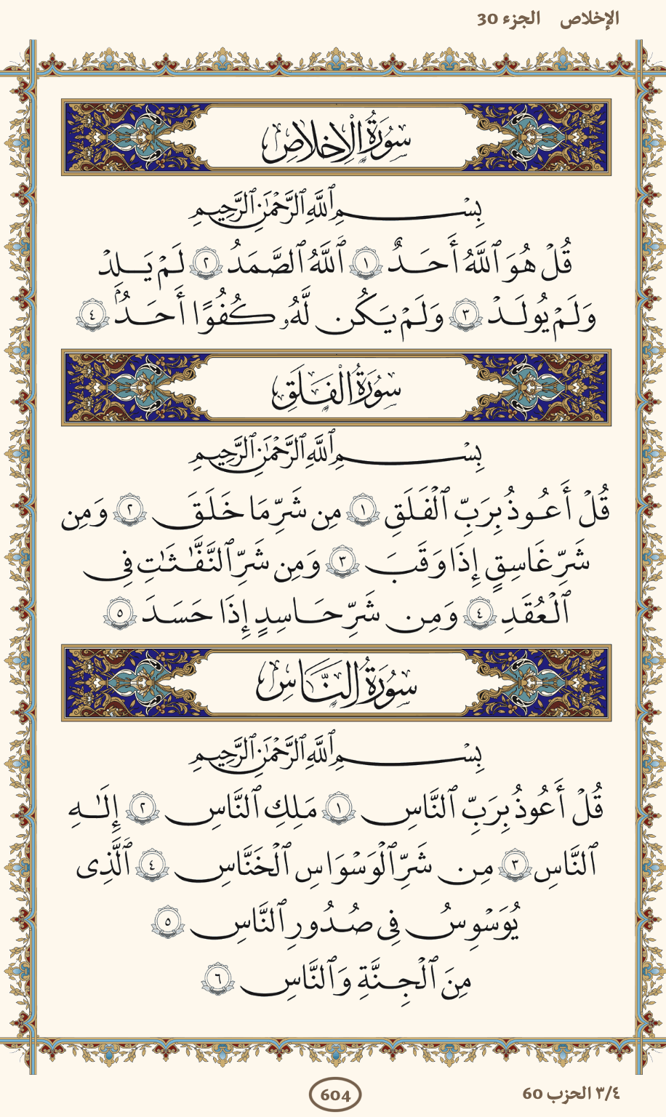
JUZ 30

Slide 4
WHY THE QURAN ?
iMAGINE THAT YOU HAVE A FINAL MESSAGE TO SAY TO SOMEONE YOU LOVE, THEN YOU’LL MEET AGAIN AFTER 1 YEAR
HOW YOUR MESSAGE WILL LOOK LIKE ?
IT WILL Rich, personal, eternal !
The Quran is the final message from a loving god to us humans.

Slide 5

Analytical View of the HOLY Quran

Slide 6
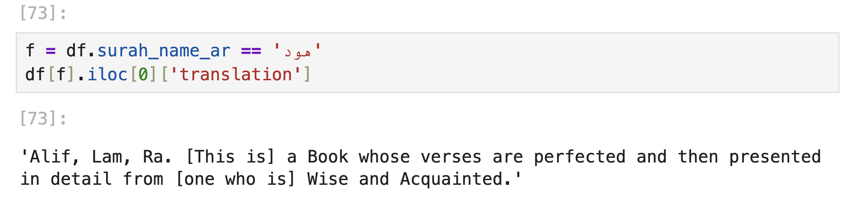
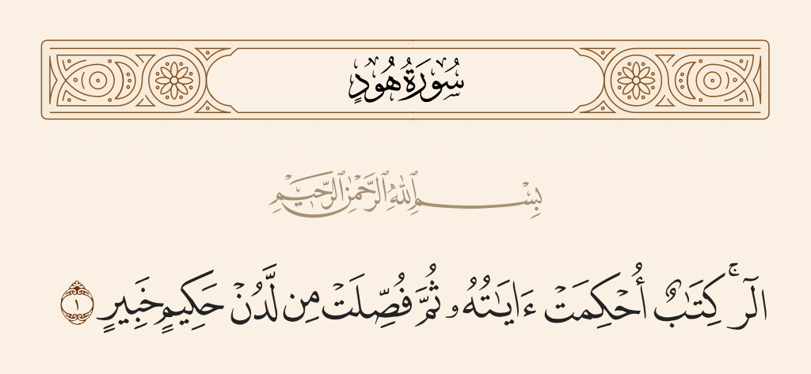

Slide 7
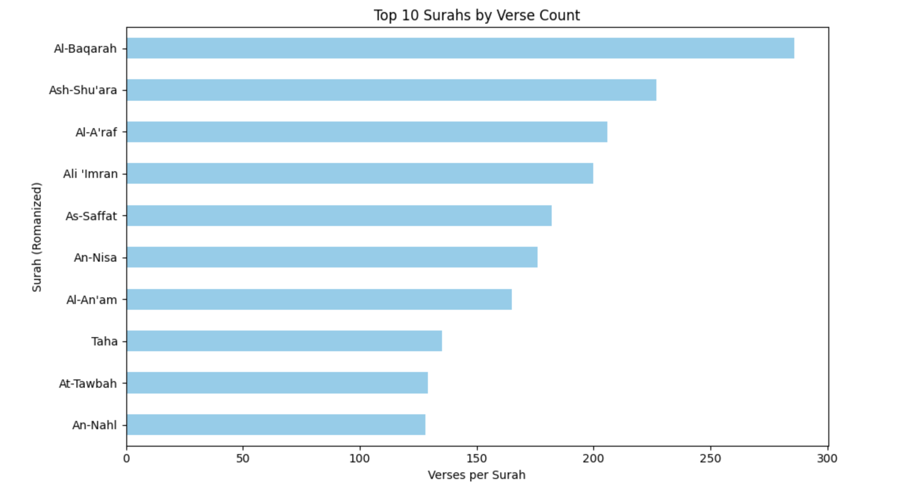
Top

Slide 8
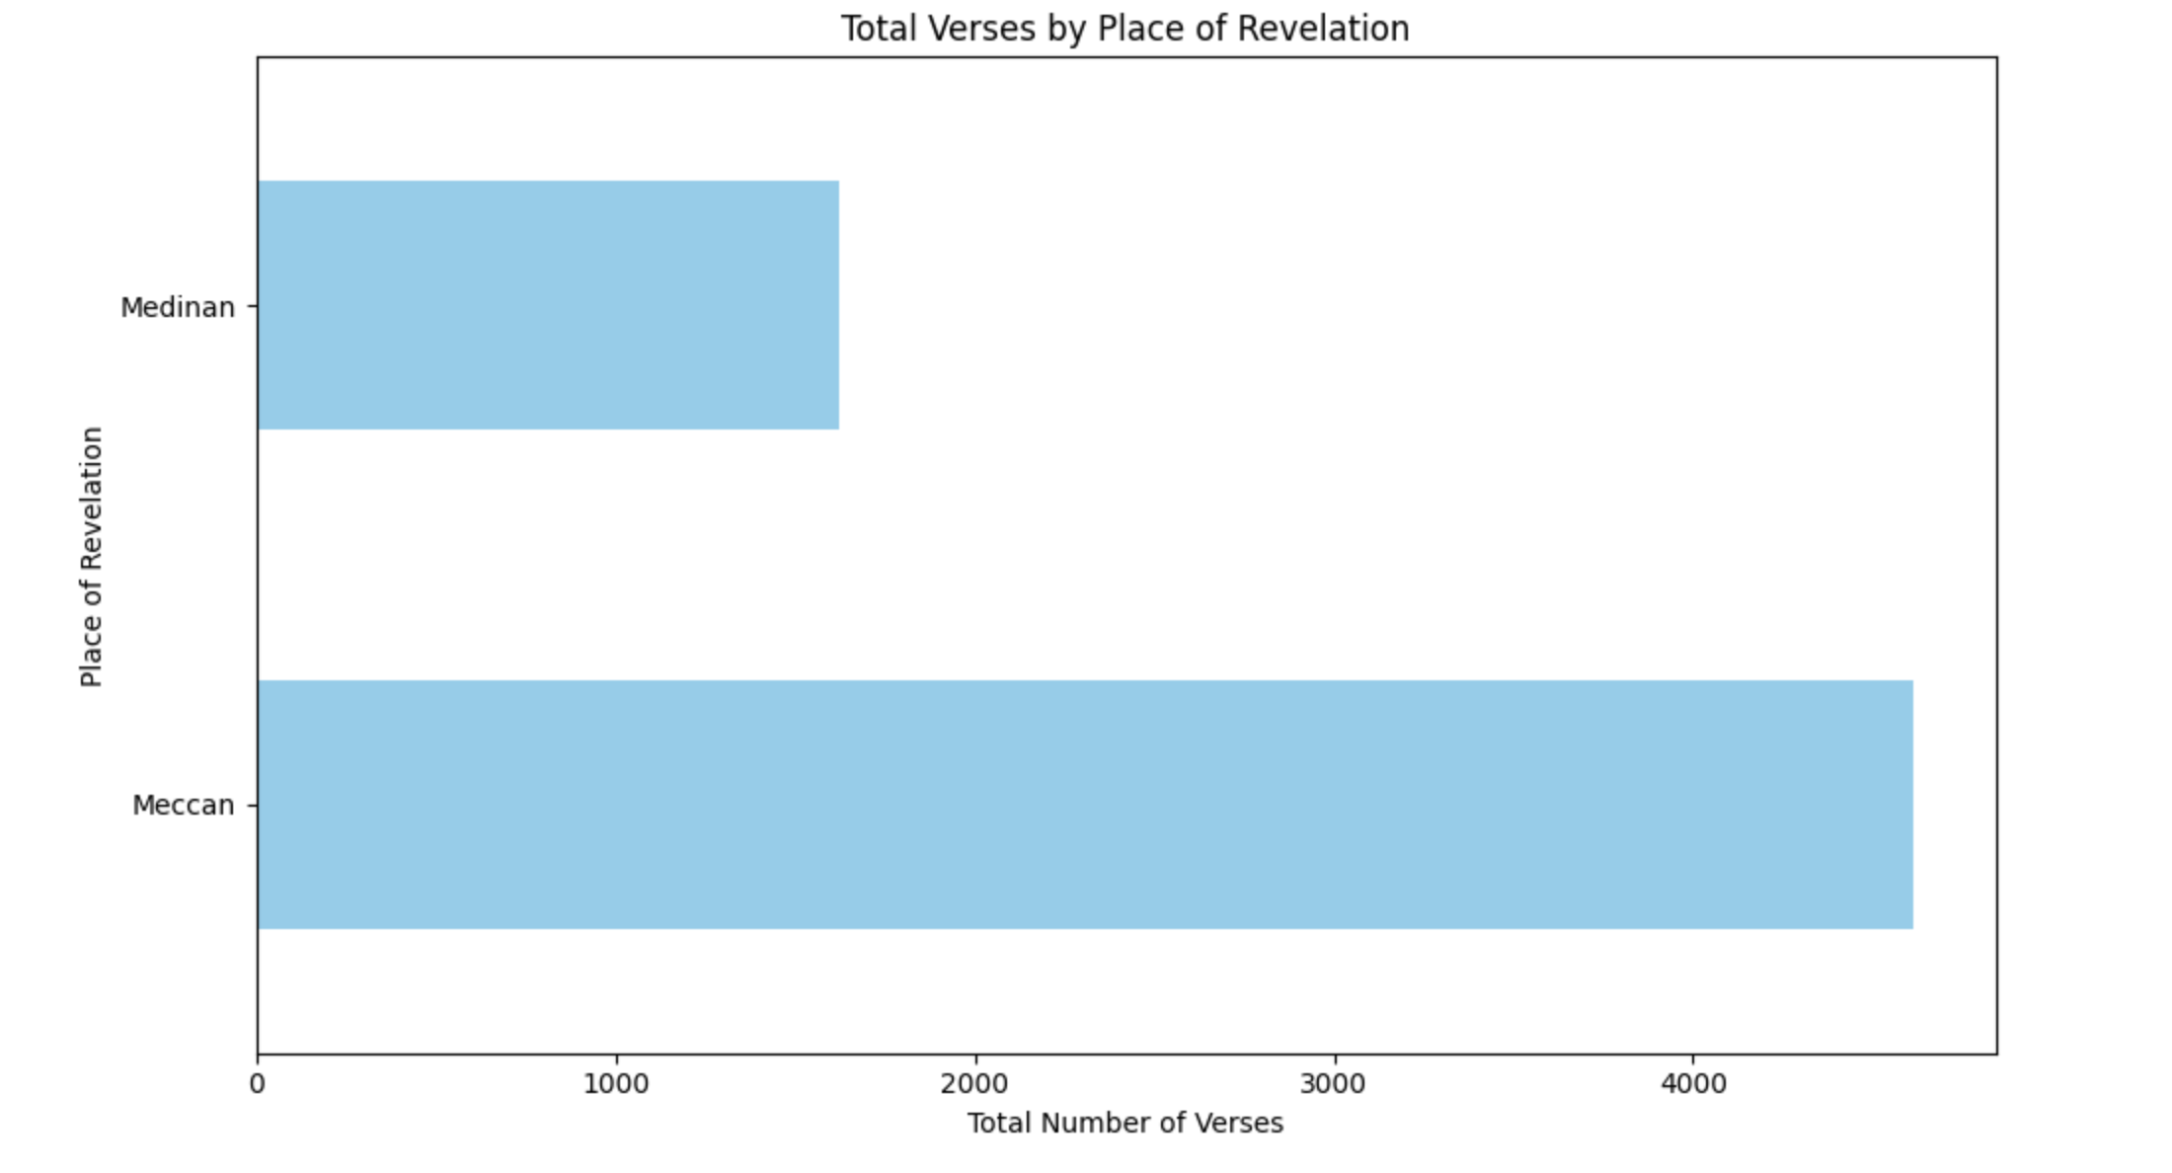
Around “1000 Verses”
> 4000 Verses

Slide 9
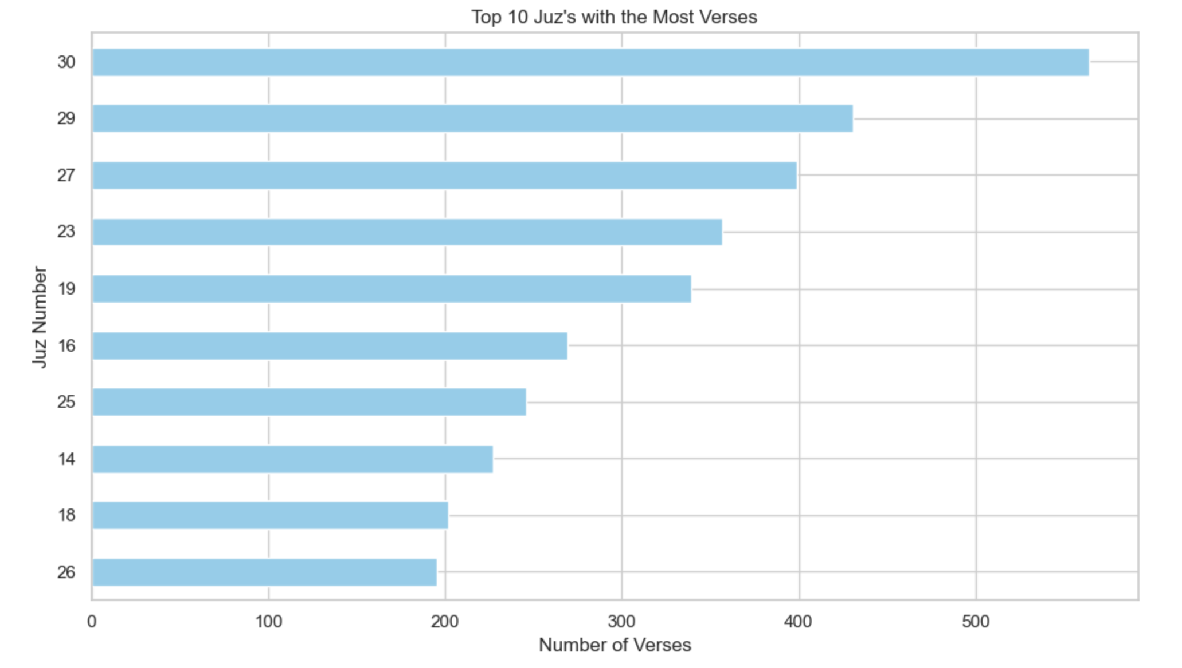
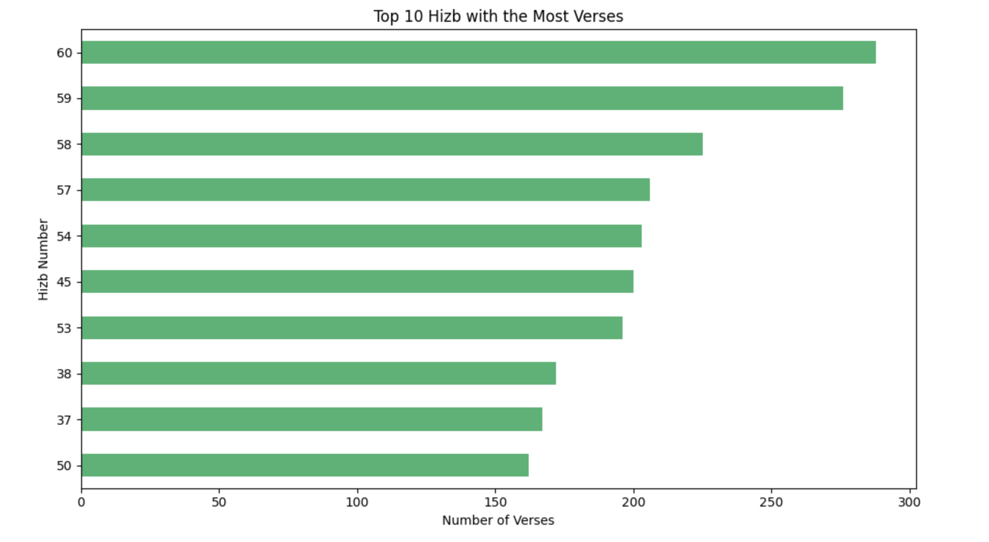
Adding verse counts from Hizb 59 and 60 gives the total verses in Juz 30 — the dots connect!

Slide 10
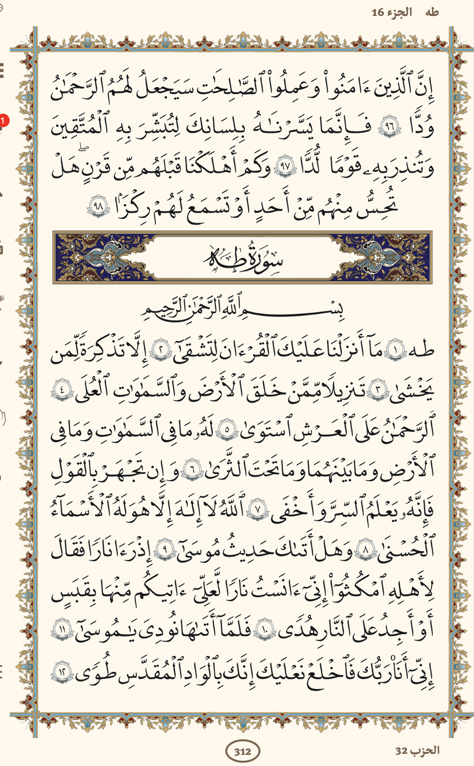
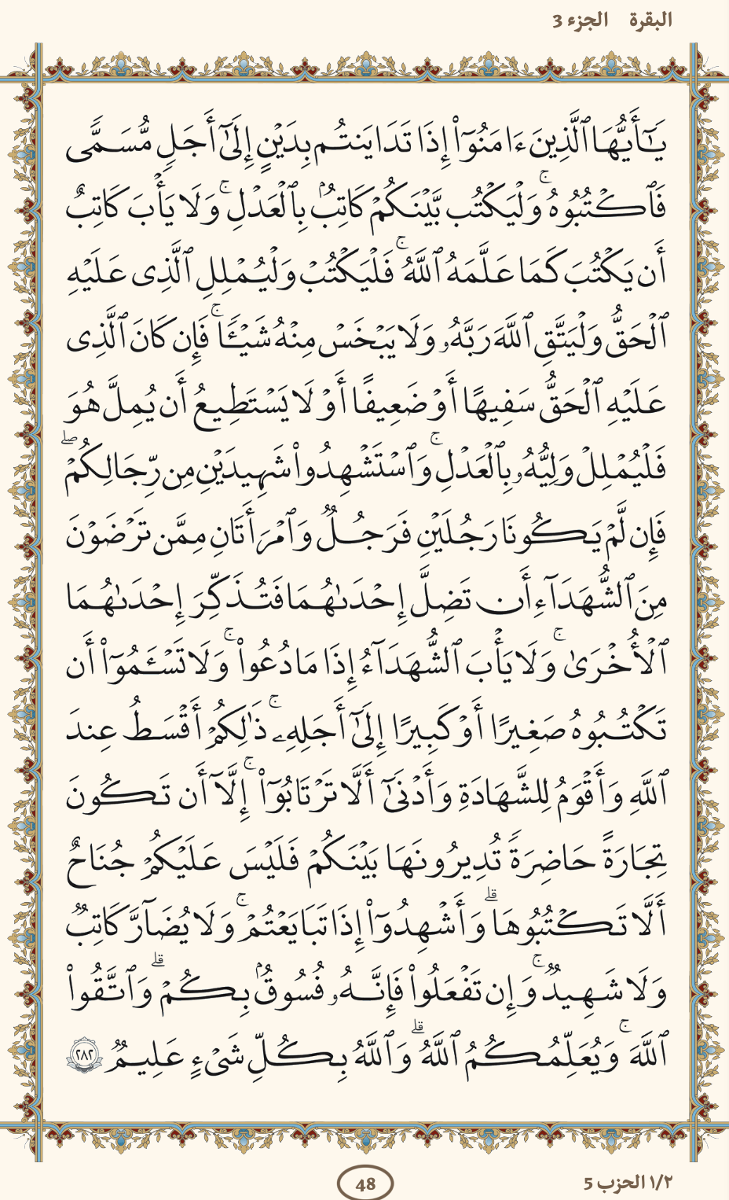
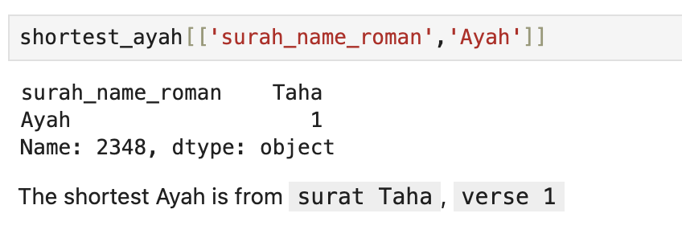
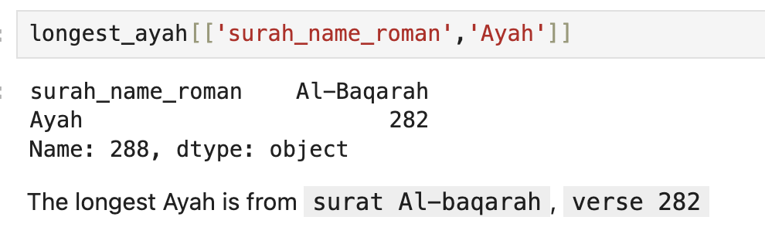
What is the longest and shortest Ayahs (by number of words)?
آية الدين
Notes:
Put the photo of the ayah here

Slide 11
MORE ANALYTICS

Slide 12
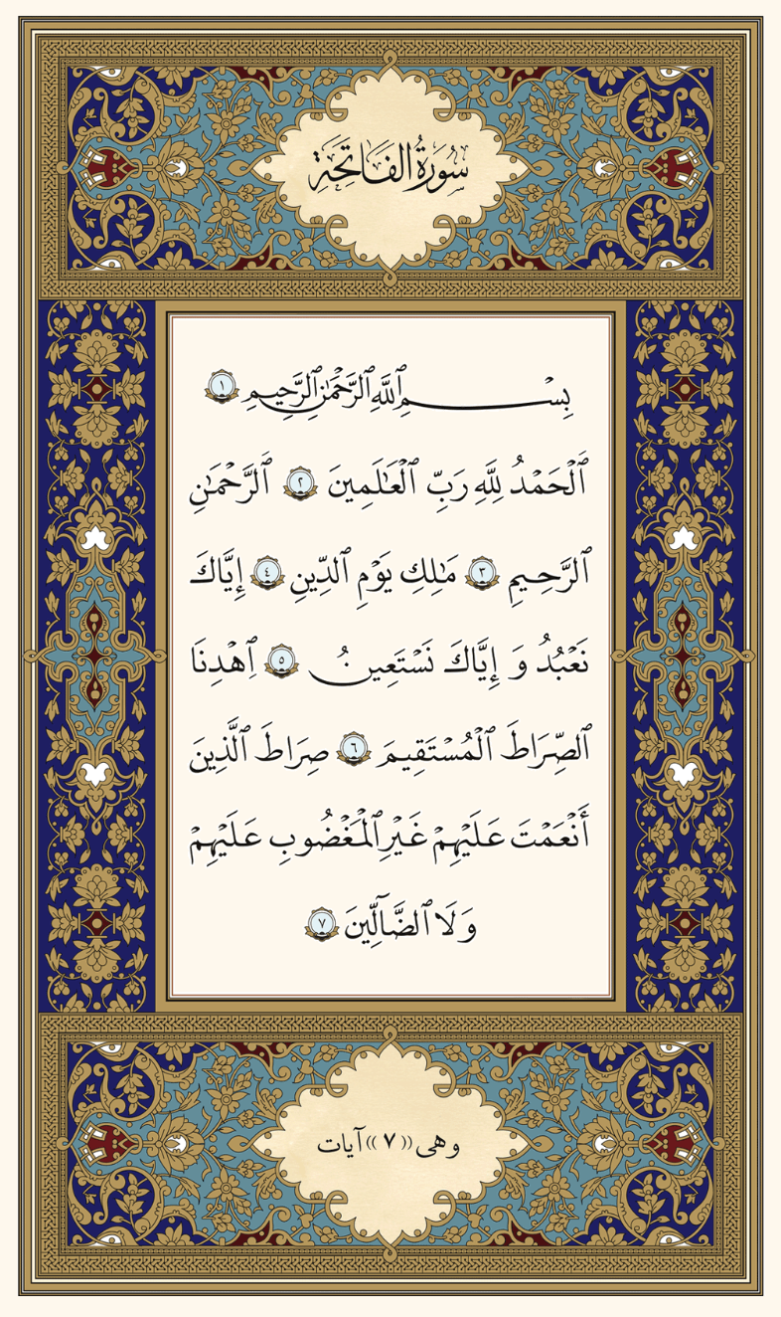
سورة الفاتحة

Slide 13
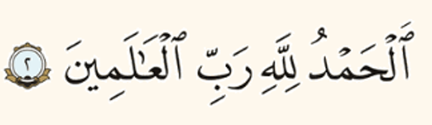
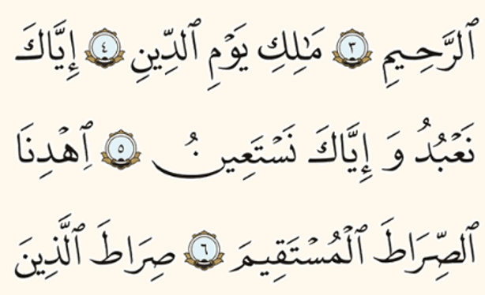
3 words
3 words
5 words
Total words here =
14
Total Ayahs here “4”
3 words
3 words
5 words
3 words
3 words

Slide 14
Total words here =
14
Total Ayahs here “4”
3.5 words
Avg =
14
4
On average we have 3.5 words per ayah
مهم
ثلاثُ كلمات تقريباً

Slide 15
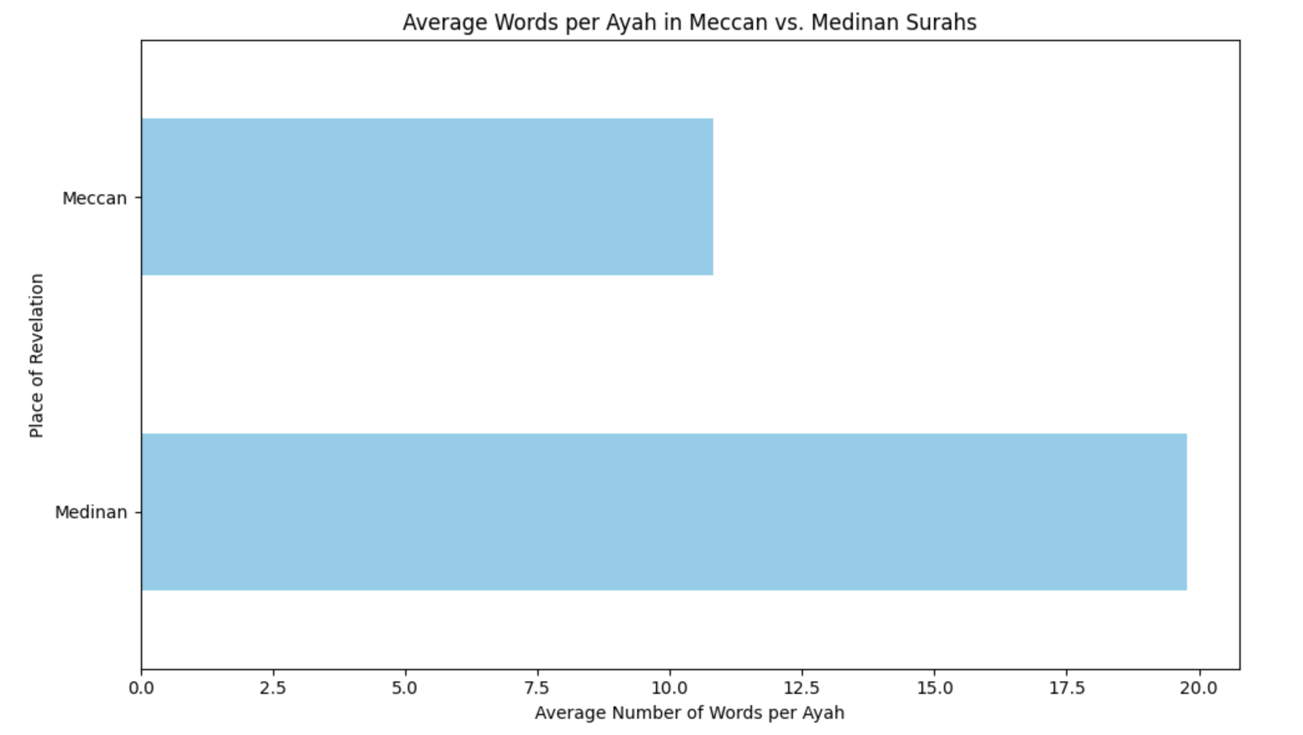
Now we can all understand such graph
Shorter Avg
BUT WHY IS THAT ?
WE’LL SEE …
Longer Avg

Slide 16
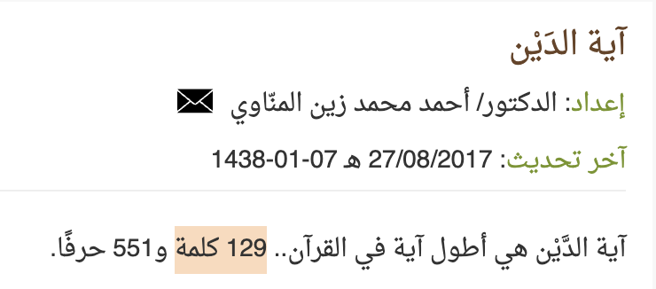
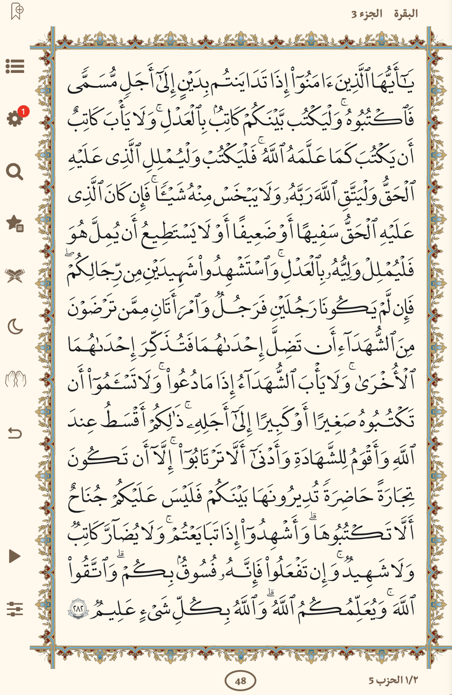
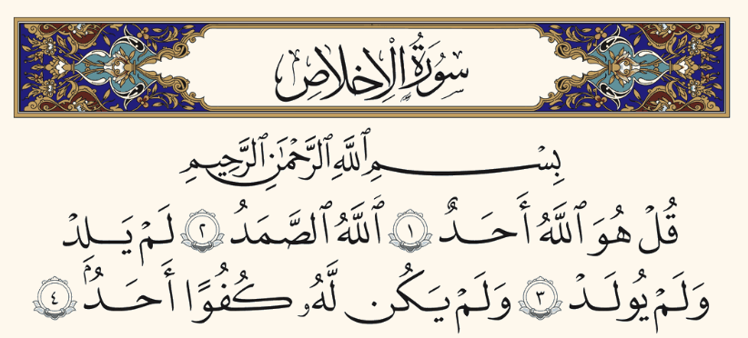
Example
Medinan
مدنية
Meccan
مكية
129 words
4 words

Slide 17
Now we can coclude that
Meccan
مكية
Medinan
مدنية
SHORTER Average of words per ayah
LONGER Average of words per ayah

Slide 18
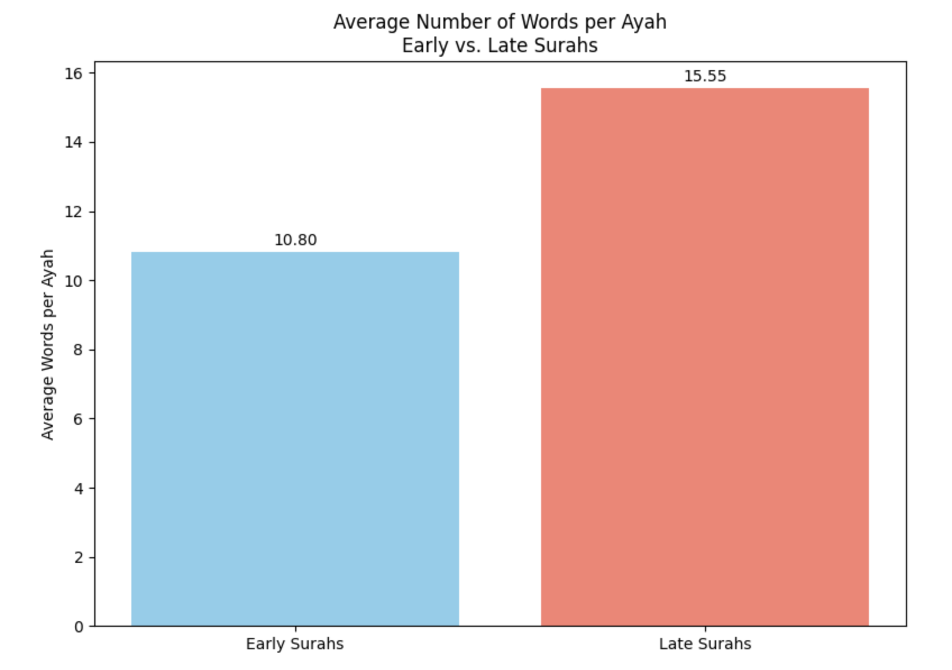
Long
Short
Mostly Medinan Surahs
Mostly Meccan Surahs

Slide 19
How does the average number of words per ayah change over the 23 years of the Qur’an’s revelation?
Quran App
Short verses first, then long verses ?
What do you guys think ?

Slide 20
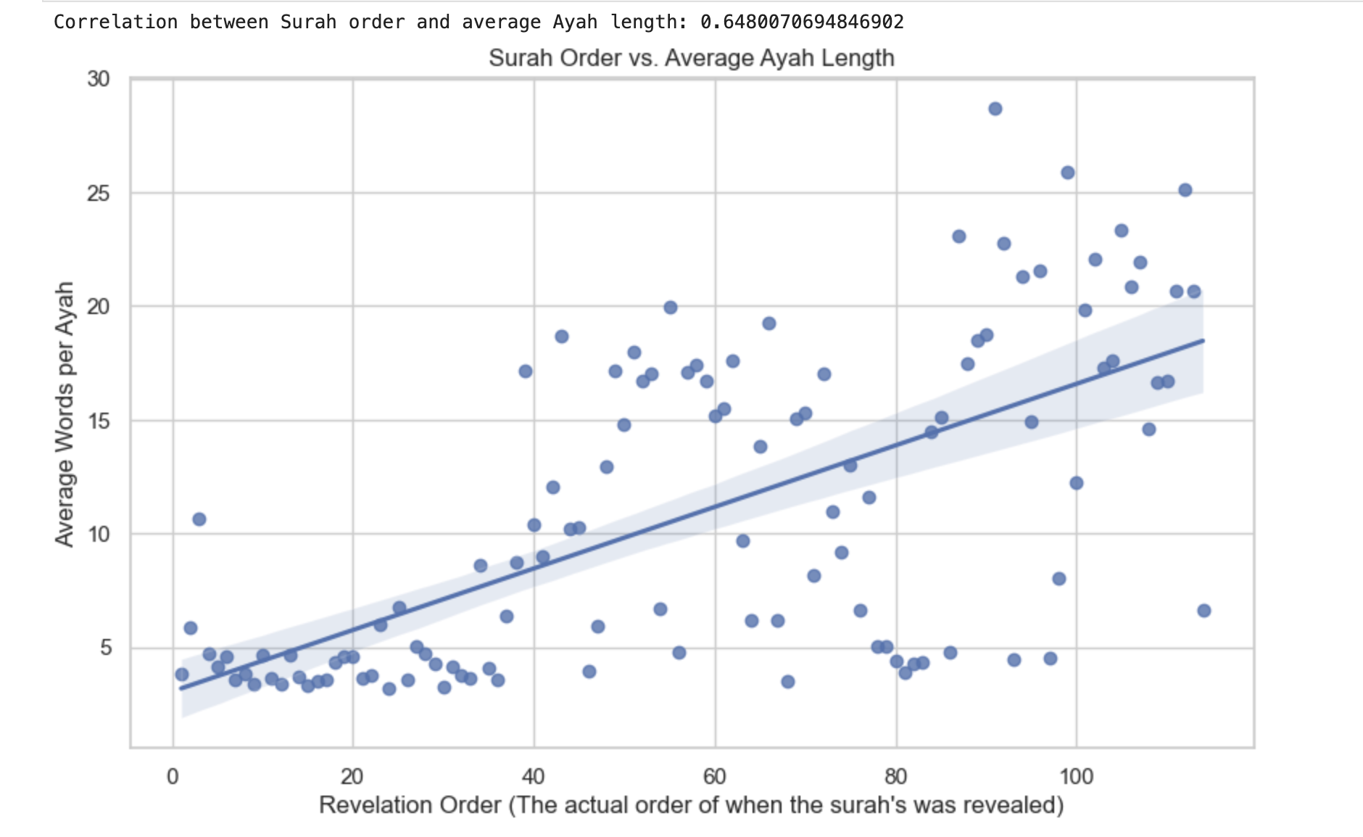
The Answer
Longer Verses
Short + 1
Short
النصر
العلق

Slide 21
A general rule of thumb in life is that everything should start easy and gradually increase in difficulty. Nothing begins as hard from the start. As humans, we progress step by step — from kindergarten to school, high school, university, and eventually to work and beyond. This is a natural law: سنة من سنن الله a divine principle of how life unfolds

Slide 22
Can we notice the difference in reading this Ayah ?

Slide 23
NLP

Slide 24
Is the weather cloudy today ?
Yes ?
Let’s make a qur'anic word cloud

Slide 25
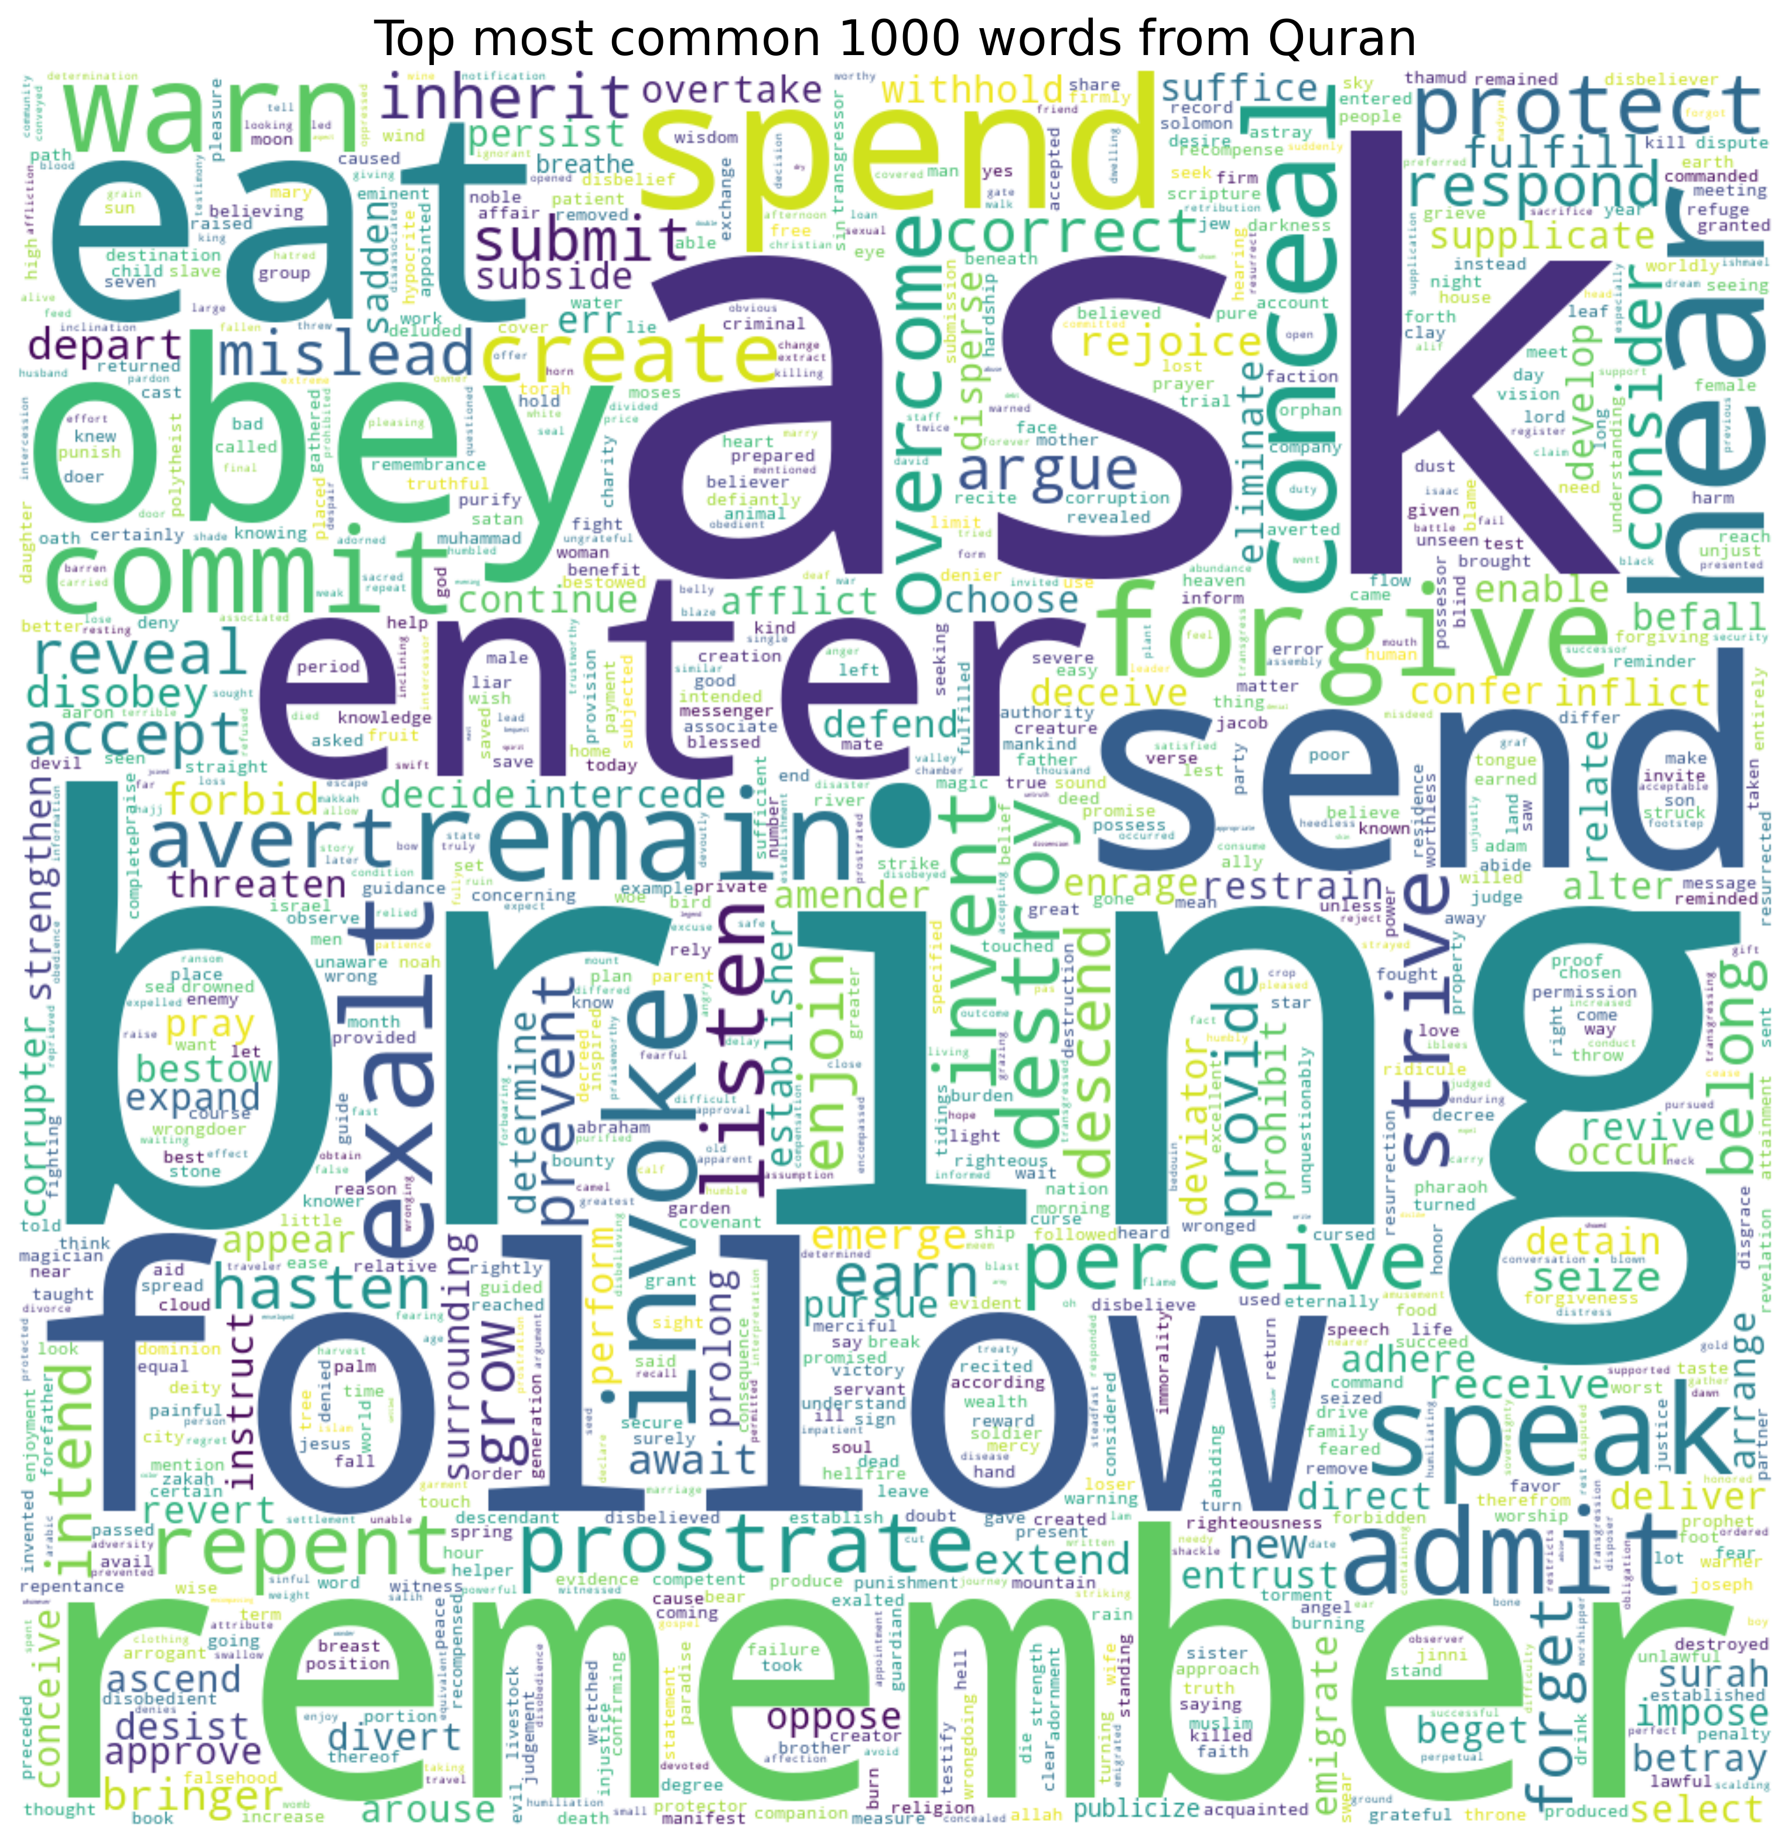

Slide 26
TOPIC MODELING

Slide 27
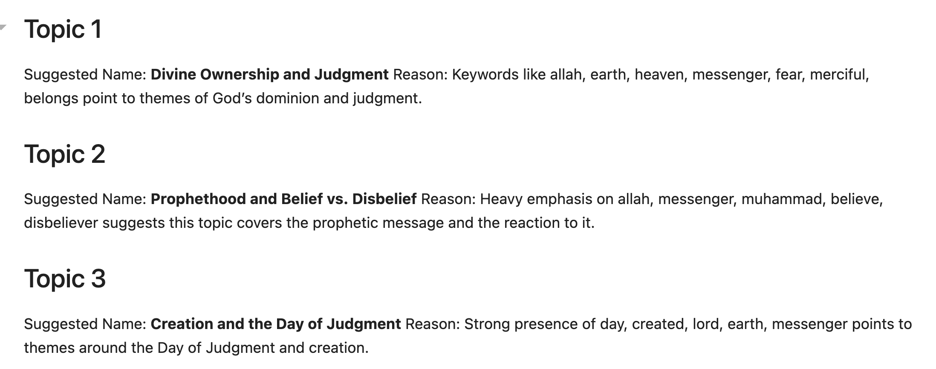
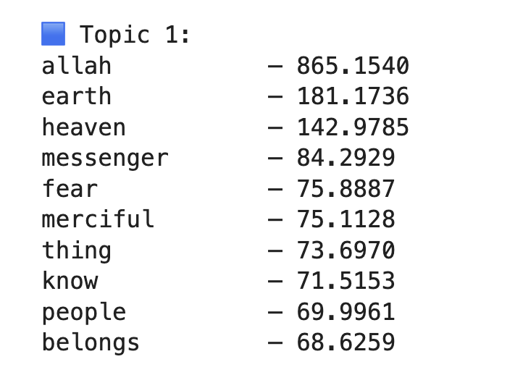
NAME the topic yourself or use
CHATGPT
Importance

Slide 28
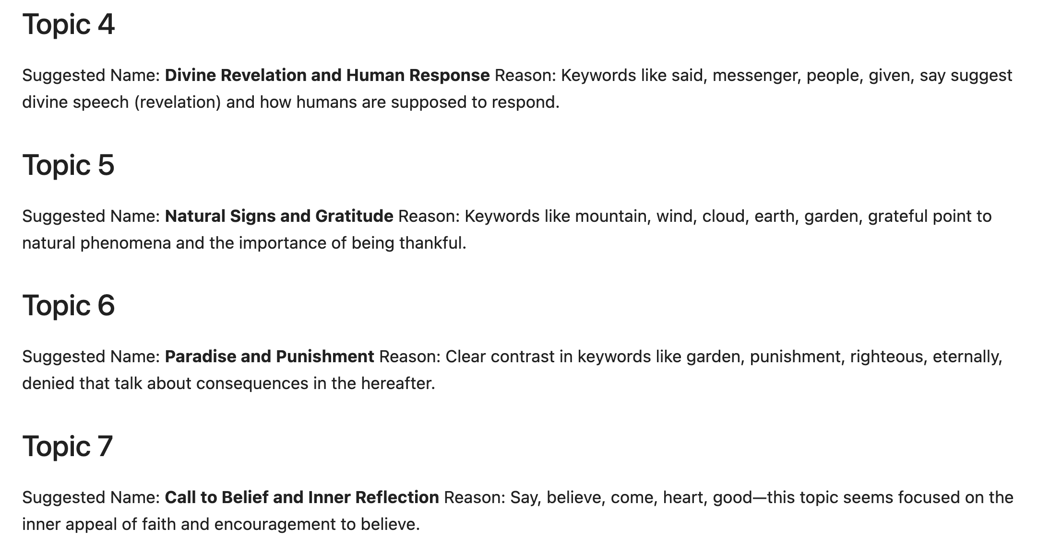

Slide 29
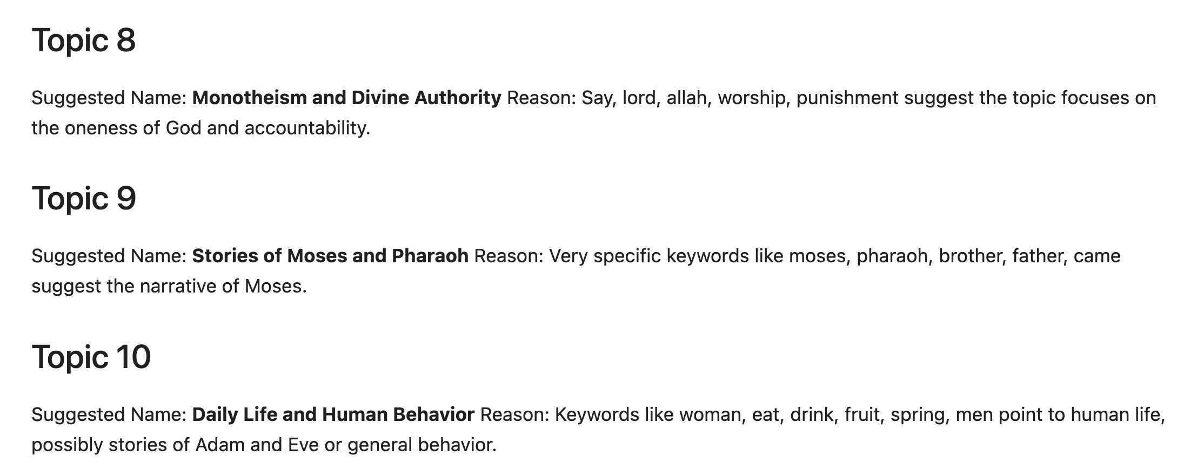

Slide 30
Recommendations

Slide 31
1. The Quran is a way of living —embrace it as a lifestyle.
1. القرآن الكريم هو أسلوب حياة، فاعتبره أسلوب حياة.
2. Don’t just read the holy book—reflect on how God presents each Surah. For example, how does He begin Surah Al-Baqarah?
تفكر
تدبر

Slide 32
وَ آخِرُ دَعْواهُمْ أَنِ الْحَمْدُ لِلَّهِ رَبِّ الْعالَمِينَ

Slide 33
MANY THANKS EVERYONE

